Slide 1

Predicting the flavor profile of beer by characteristics
ITMO University
ChemBio Cluster
Educational Program: Chemistry and artificial intelligence
Completed by: Sarkisyan Arsen Karenovich, A4130
Verified by: Serov Nikita Sergeevich

Slide 2
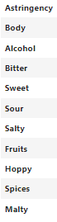


Beer
About project
Description
Goals
Example of flavor characteristics
Our project is a unique fusion of brewing and modern technology.
We are developing a service with a machine learning model that can predict the style of beer based on its characteristics.
Minimum plan: Predicting beer styles by available characteristics such as ABV, IBU and others..
Maximum plan: Output a recipe similar to what the user is requesting.

Slide 3
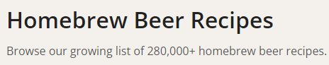
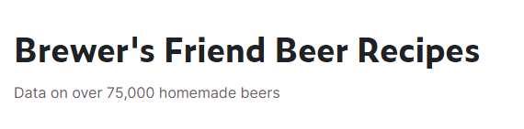
Relevance
Beer
In addition to active research in the field of creating models for predicting the flavor profile of beer, there is an increased interest on the part of both large breweries and independent breweries in developing new methods for analyzing and predicting flavor characteristics. This indicates the significant relevance and potential application of our research in the context of current trends in the industry.
The large community of home brewers is committed to perfecting their recipes, as evidenced by the presence of online sites and databases with recipes and beer drink specifications.

Slide 4
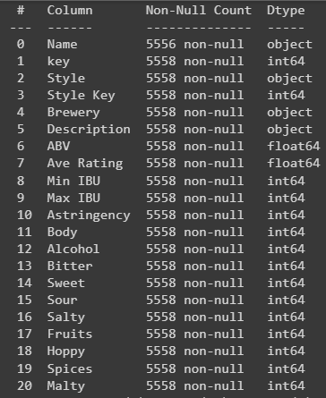

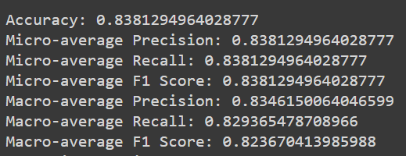
Purpose and objectives
Beer
Data collection
We have collected several datasets, the main one containing 5556 public domain recipes from sites where users share their brewing results and flavors.
Data handling
The dataset has been analyzed and cleaned of errors, and is now ready for training models on it.
Model training
Work was done to find the optimal model. The results showed that the Random Forest Classifier model shows the best results. The prediction accuracy varies in the range of 81-85%

Slide 5

Purpose and objectives
Beer
Increased performance
Improved metrics performance
Adding functions
There is a possibility that it is possible to predict style from other characteristics as well. In the future it is planned to add descriptors and try to implement this.
I believe it is possible to achieve at least 90% accuracy, but it takes time.
There are plans to add a recommendation system.
The ability to describe the drink in words and get the result.
Ability to receive not only the style and the nearest recipe but also instructions for preparation

Slide 6

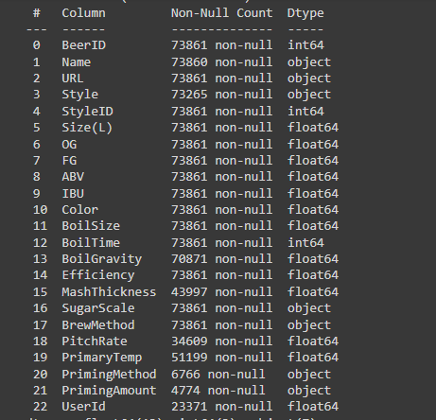
Additionally
Beer
In parallel with the work on the main dataset, I was doing research to find additional information. I came across a voluminous dataset with a large number of final beer characteristics and 73 thousand recipes.
This dataset has been thoroughly analyzed and cleaned of various outliers and incorrect data.
After all the dataset preparation, I tried to use it to predict beer styles, but this dataset turned out to have a severe class imbalance.
I decided to enrich this dataset in case it will be useful to me in the future and parsed a huge number of descriptors.
You can read the research work on data and parsing by following the link to my GitHub repository

Slide 7
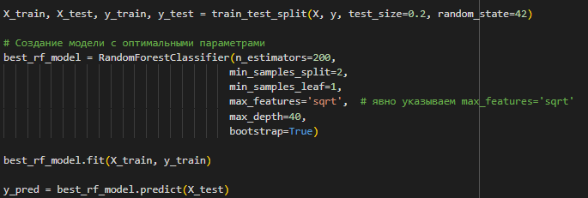
The main research methods
Beer
To achieve the objectives, machine learning techniques were used to analyze the dependencies of the features in the dataset and to build a prediction model.
Random Forest Classifier model is used to predict Beer Style

Slide 8
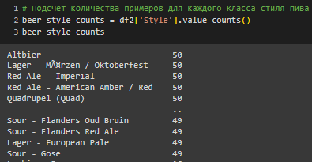
Results
Beer
Using open source data and a dataset downloaded from Kaggle, a dataset of 5556 rows was collected. All data was analyzed, including checking for class imbalance. The subject area was studied and dependencies and correlations were found.

Slide 9
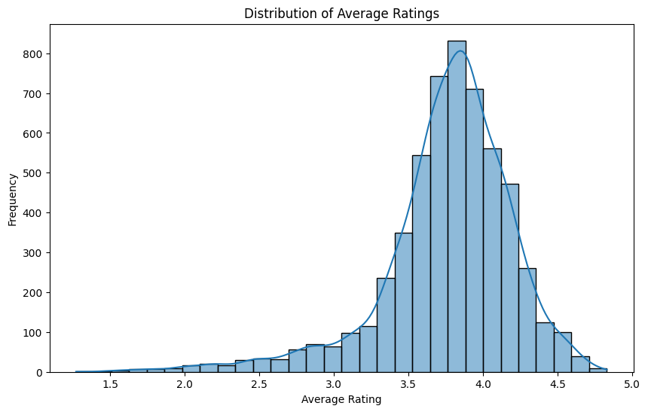
Results
Beer
The following will present the research paper and data analysis as well as a little commentary.
Recipes with ratings between 3.6 and 4.0 are more common than others. Considering that there are no recipes with a rating of 5 at all (because nothing is perfect), most of the recipes were rated well by users, which is a positive quality for us.

Slide 10
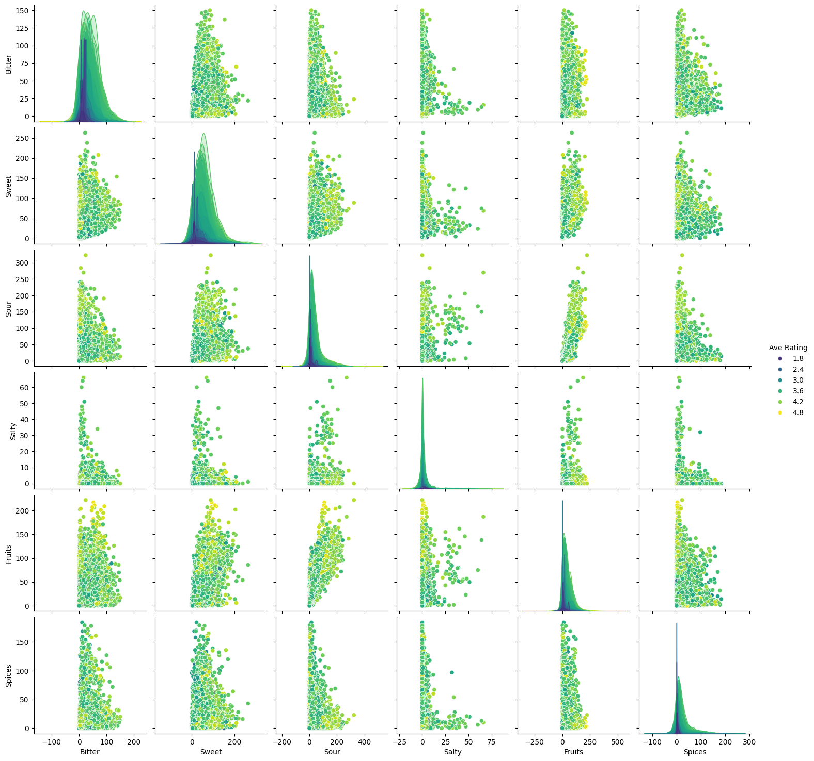
Results
Beer
Diagonal histograms and kernel density estimates (KDEs):The main diagonal contains the histograms or KDEs for each variable, allowing us to estimate their distribution.
From this we can conclude that the dataset presents varieties of different degrees of bitterness and sweetness, with the least bitter or least sweet recipes having a lower rating of less than 3.0.
But there are not so many highly salty recipes, which is obvious, because beer is not a salty drink for the most part.

Slide 11
Results
Beer
Judging from the graph, it is the fruit flavor that gives sourness to the drink: the higher the Fruits value. the higher the Sour value.
The difference in the color of the dots on the graph is also noticeable: they are darker on the bottom left than on the bottom right, which indicates that drinks with higher values of Fruits and Sour have a higher rating.
Whereas drinks with a strong fruity flavor but little sourness have a lower rating. A low Sour score negatively affects the rating of a recipe.
Sweet paired with other flavor characteristics does not have a strong effect on the rating. Spices at low values paired with other flavor profiles create a good consumer experience.

Slide 12
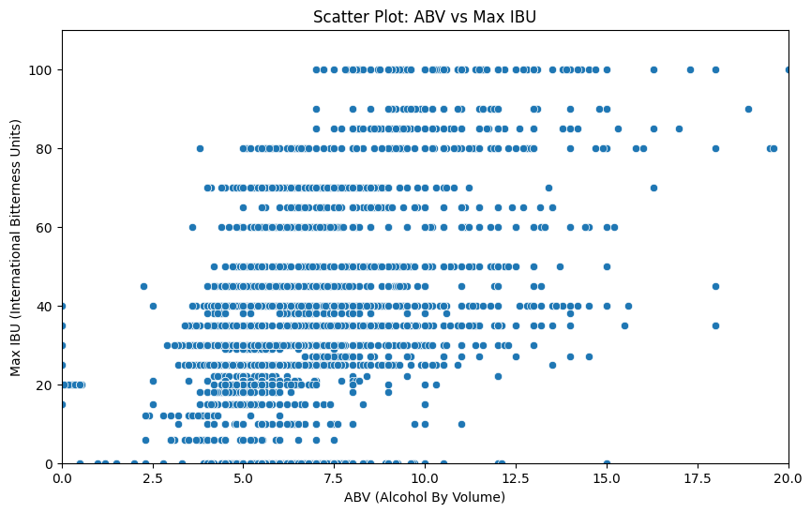
Results
Beer
Trend: The graph does not show a clear linear trend between ABV and Max IBU. However, as the maximum bitterness level in the recipe increases, the ABV increases in most cases.
Data scatter: The data on both axes are scattered in different areas of the graph, which may indicate a variety of beer styles with different alcohol and bitterness levels.
Clusters: We can note the presence of clusters where points cluster in certain areas of the graph. This is not due to the bitterness characteristic itself, but to the format of the data display in this column - the data is of integer type.

Slide 13
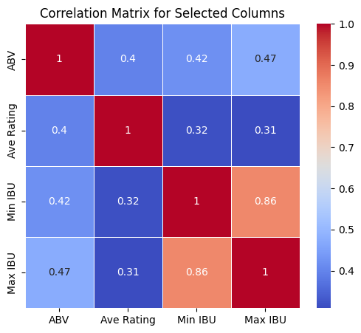
Results
Beer
Weak and strong positive correlations
It seems obvious that Min IBU and Max IBU should have a high correlation coefficient. However, this is not the case, a high correlation coefficient in this case may indicate a stable bitterness level in the beer.
ABV and Ave Rating have a moderate positive correlation: the coefficient is 0.4. This may indicate the following trend: people tend to rate slightly higher stronger beers.
The correlation coefficients of 0.42 for Min IBU and 0.47 for Max IBU with Ave Rating indicate a moderate positive correlation between bitterness level and average beer rating. This may imply that beers with higher bitterness levels (measured as International Bitterness Units, IBU) tend to receive higher average ratings from consumers.
However, correlation does not imply causation.

Slide 14
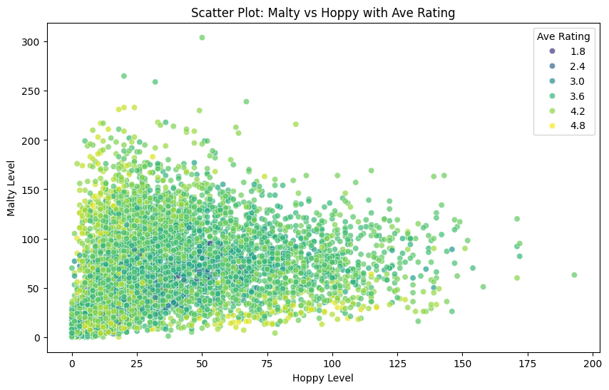
Results
Beer
Beers with a balance between malt and hops:
The chart shows that beers with moderate levels of both malt and hops (in the middle of the range) have lower average scores. This may be because such beers may not have pronounced malt or hop characteristics, making them less interesting to some connoisseurs.
High hop, low malt and highest scores:
Beers with high hop content and low malt have the highest average scores. This may be due to the preference of a certain group of consumers for more bitter and flavorful beers, especially in the context of current flavor trends.
High malt, low hops and highest scores:
Beers with high malt and low hops also show high average scores. This may be of interest to those who prefer the more intense flavor characteristics of malt.

Slide 15
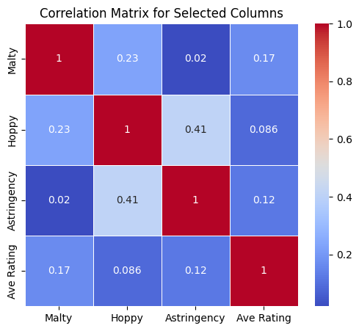
Results
Beer
Astringency in refers to an astringent flavor that can resemble dryness, tightness, or an astringent sensation in the mouth. The main source of astringency in beer is tannins, which can be extracted from malt, hops, and other ingredients during brewing. Tannins are polyphenolic compounds that can impart astringent properties to wines, teas, and some beers.
Malts and hops can release tannins during the brewing process, especially if the brewing temperature is too high or if the water has a high pH level. Incorrect brewing parameters can lead to excessive extraction of tannins and hence increased astringency in beer.
A correlation coefficient of 0.42 may indicate a moderate positive linear relationship between the variables Hoppy and Astringency. This means that as the level of Hoppy increases, the level of Astringency is likely to increase as well.

Slide 16
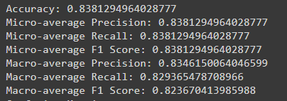
Results
Beer
To summarize, I got a lot of information for future work. Next I used LazyClassifier which showed the best performance for the random forest model. I customized hyper parameters for this model and got good results.

Slide 17
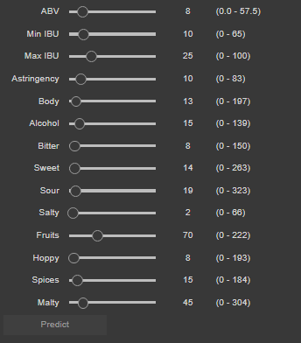
Results
Тема
In the end I developed a simple interactive interface for users

Slide 18
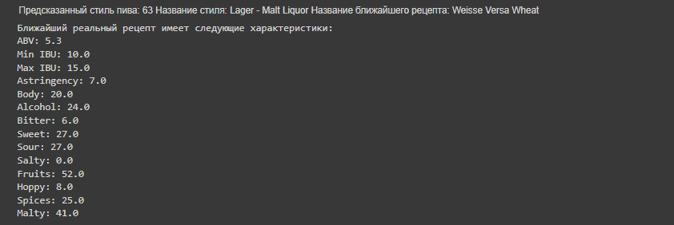
Results
Beer
After selecting the characteristics and clicking the "Predict" button, the user gets the name of the beer style and the nearest existing recipe from those that exist in the dataset.

Slide 19
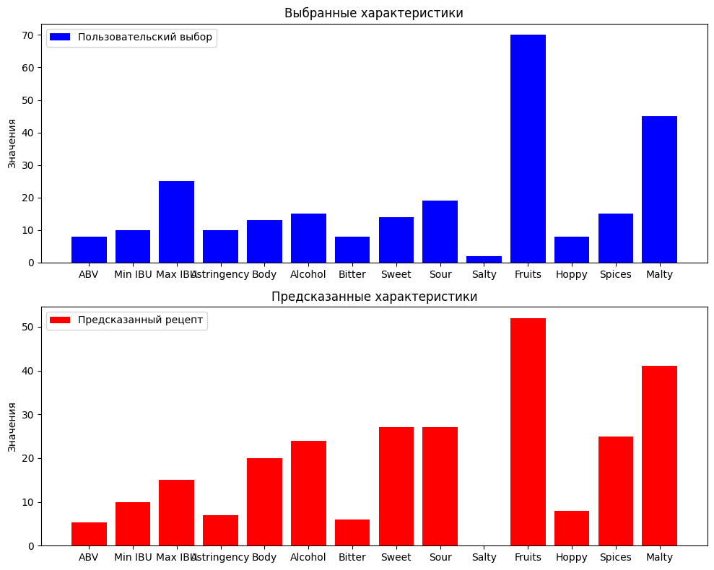
Results
Beer
To compare the recommended recipe with the one selected by the user, two graphs are displayed.

Slide 20


Conclusion
Beer
As a result, I have 2 datasets, one of which I enriched with additional descriptors.
Based on the second dataset, the research work was done and the model was trained The model was customized and used.
All goals and objectives were realized and MVP was created.
Application
Commercial prospects
These predictions can help brewers optimize processes, modify recipes to meet requirements, and create better products.
Creating a new descriptive process in the food industry, to formalize attributes such as taste, color and smell.

Slide 21


Results
Beer
List of sources used:
Beer Recipe Exploratory Analysis. This analysis provides a survey of beer recipe data that can be useful in understanding the main characteristics of different types of beer. Link
Data Cleaning & Integration with Pandas and FuzzyWuzzy. This material contains information about data cleaning and integration methods using Pandas and FuzzyWuzzy libraries, which may be useful for preprocessing beer data. Link
Top Beer Information Dataset. This dataset provides information about different types of beer and their descriptions, which can be useful for analyzing and classifying beer according to various parameters. Link
Beer Profile and Ratings Dataset. This dataset contains profiles and ratings of different beers, which can be useful for researching the taste preferences and properties of different beer styles. Link
Beer Recipes Dataset. This dataset provides recipes for different types of beer, which can be useful for analyzing the composition and characteristics of different beer styles. Link
Rudnitskaya, Alisa, Evgeny Polshin, Dmitry Kirsanov, Jeroen Lammertyn, Bart Nicolai, Daan Saison, Freddy R. Delvaux, Filip Delvaux, and Andrey Legin. "Instrumental measurement of beer taste attributes using an electronic tongue." Analytica chimica acta 646, no. 1-2 (2009): 111-118.Gf
Bettenhausen, Harmonie M., Amanda Benson, Scott Fisk, Dustin Herb, Javier Hernandez, Juyun Lim, Sue H. Queisser et al. "Variation in sensory attributes and volatile compounds in beers brewed from genetically distinct malts: an integrated sensory and non-targeted metabolomics approach." Journal of the American Society of Brewing Chemists 78, no. 2 (2020): 136-152.
Lehnhardt, F., J. Steiner, M. Gastl, and T. Becker. "Prediction power and accuracy of forced ageing-matching sensory and analytical results for lager beer." Brew. Sci 71 (2018): 39-48.

